Slide 1
What is phonics? -How children learn phonics
EYFS PHONICS TIPS – Happy Little Hearts

Slide 2
A Quick Guide
This presentation will give you some tips and ideas on how to support your child with their phonics at home.
Phonics has now become an essential part of learning in the eyfs and is very important to implement in your Childs learning to support them in their name writing and simple segmenting and blending.

Slide 3
Teaching phonics...
When teaching phonics there is a guideline to follow which will be explained in detail during this presentation
Phase 1/2 phonic sounds – Letters and Sounds
Letter recognition
Letter formation
Segmenting and blending
Simple CVC sounds

Slide 4
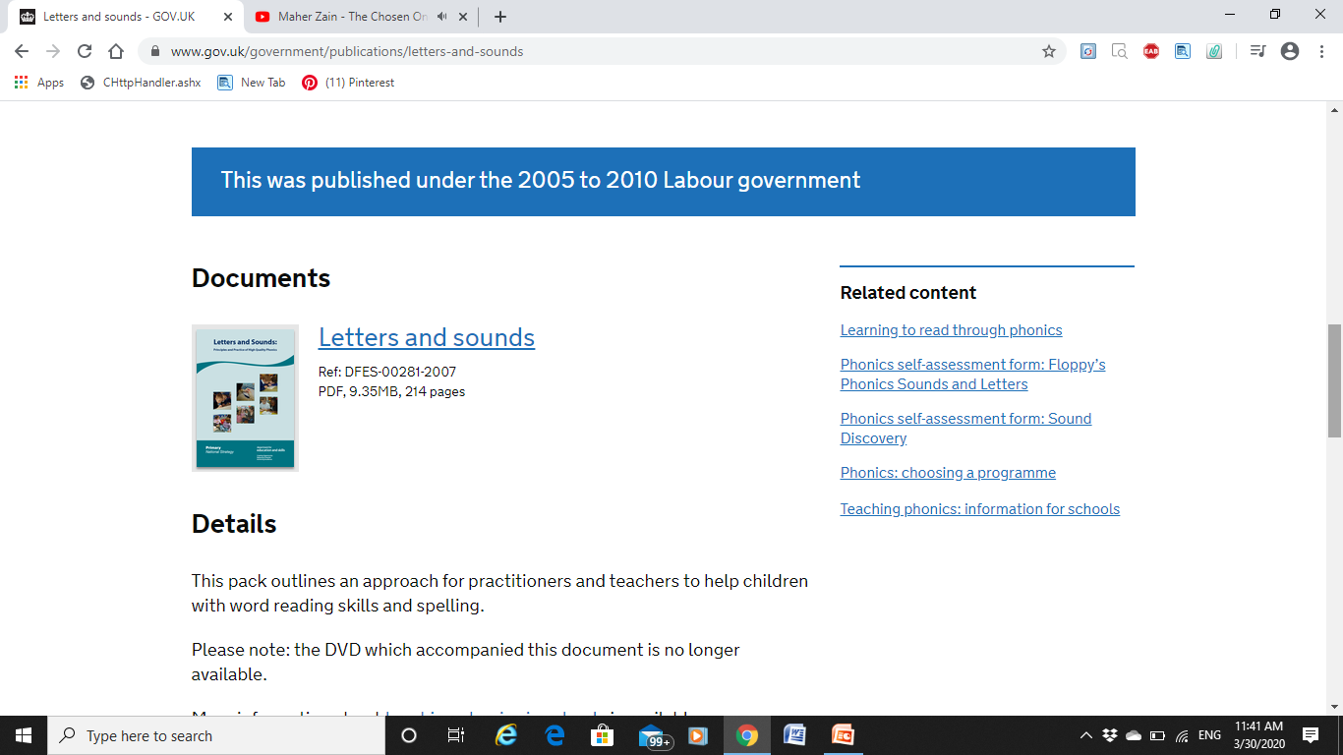
Step by step ...
How do we teach phonics ?
Where do we start?
Its simple...
We use a curriculum called
‘Letters and Sounds’ to help key
workers teach their students
phonics
It is also found as a
downloadable copy online on
the link below
https://www.gov.uk/government/publications/letters-and-sounds
Click on this link to access the document

Slide 5
Phase 1 & 2 sounds
Phase 1 consists of the following sounds :
Set 1 : s,a,t,p
Set 2 : i,n,m,d
Set 3 : o,g,c,k
Phase 2 moves onto the following double sounds
Set 1 : ck ,e,u,r
Set 2: h,b,f,ff
Set 3 : l,ll,ss
We start of by teaching the children basic phase 1 sounds.
Using these sounds we look at the recognition and formation of these sounds before moving onto the next ones.
There are many ways of practising letter formation as will be explained on the following slides and on any links posted on this presentation.

Slide 6
Sound Recognition
When teaching the children phonics during their time at preschool we use the sound mat below to support their recognition of sounds that they need.
This comes first before being able to then form the letter by writing it out.For example if they need to write the name Saarah you could support them by sounding out the letters and giving them clues using pictures to prompt them into finding the right letter they need to form. The link below gives you access to a rang of sound mats you can download or print out for your child to use
https://www.twinkl.co.uk/resource/T-L-015-Phase-2-Sound-Mat

Slide 7
Letter formation
Now the tricky part! Teaching your child to write can be very tricky. Before being able to write, the most important thing is for them to be ble to grip a pencil and having good pencil control.
Using read,write inc supports your child to be able to form letters using rhymes which they will remember when writing a sound. For example when writing an ‘a’ we use ‘around the apple down the leaf’ to help with the letter formation.
A large copy will be posted on the next slide to support with letter formation
LINK will be posted on the last slide

Slide 8
Read write inc letter formation
Use these to support letter formation, the rhymes are simple and easy to remember

Slide 9
Read write inc letter formation

Slide 10
Read write inc letter formation

Slide 11
Read write inc formation

Slide 12
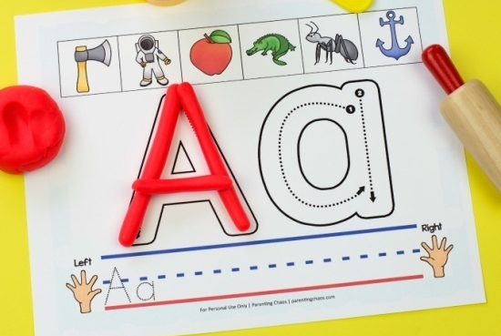
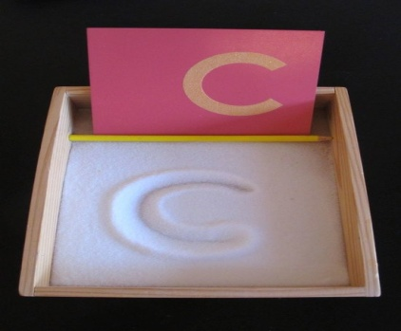
Letter formation
The letter formation rhymes will help your child to remember ways of writing the letters .
You can get them to practise writing their letters using their fingers in the air and many other ways. Below are some creative ways of practising letter formation.
Practising in sand
Wet brushes on the floor outdoors
Chalks
Playdough letter formation

Slide 13
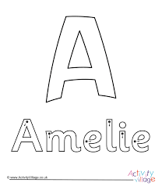
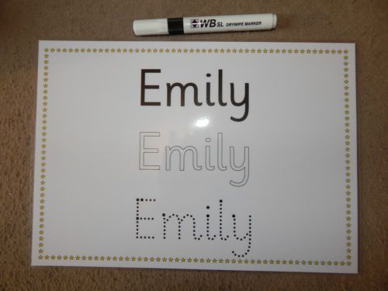
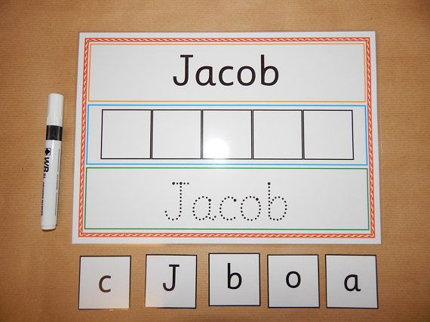
Can you write your name?
Parents please remember not to stress.
Your child does not need to be an A* student before they go to foundation, try and make sure they are practising their name writing every single day and simple phase 1 and 2 sounds . These are the basics and will help them in school.
Online are many tools for name practising, there are templates for your child to be able to go over their names using different mark making materials such as playdough, feltips and colours. Some links will be put on the final slide.

Slide 14
To be continued...
If there are any resources or pictures you have seen that you may like me to create for your child or any other support you may need please do not hesitate me via EMAIL on raeesa@happylittlehearts.org and I will be able to help you inshallah.
- I hope you have enjoyed the tips on this short presentation. Next week I will be sending out tips and trick to support your child with their reading using Segmenting and Blending and introducing short CVC words with them.
- Please keep a look out on our home link page on our website.(www.happylittlehearts.org)
LINKS to visit:
Google – Read write,inc
Twinkl
Letters and sounds - available to download online

